Slide 1
Spring Cloud Config Server

Slide 2
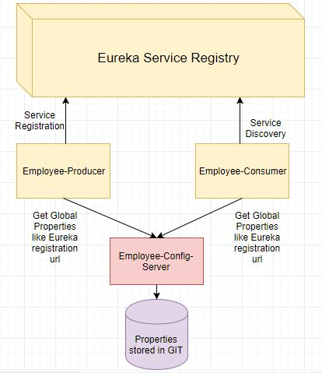

Slide 3
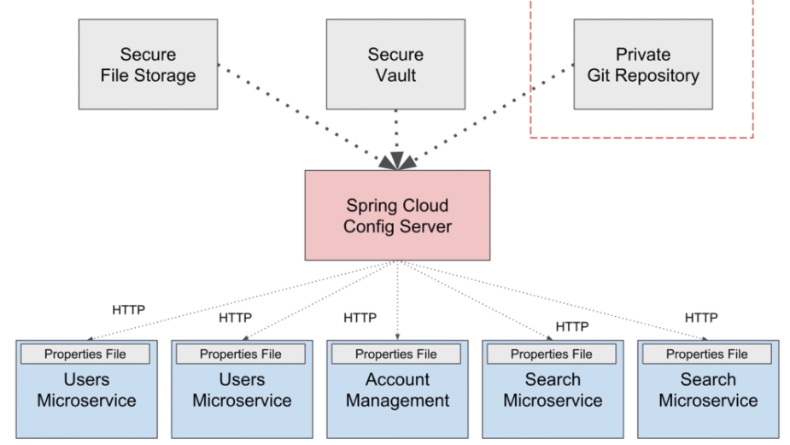

Slide 4
Create Your Own Config Server Create Private GitHub Repository

Slide 5
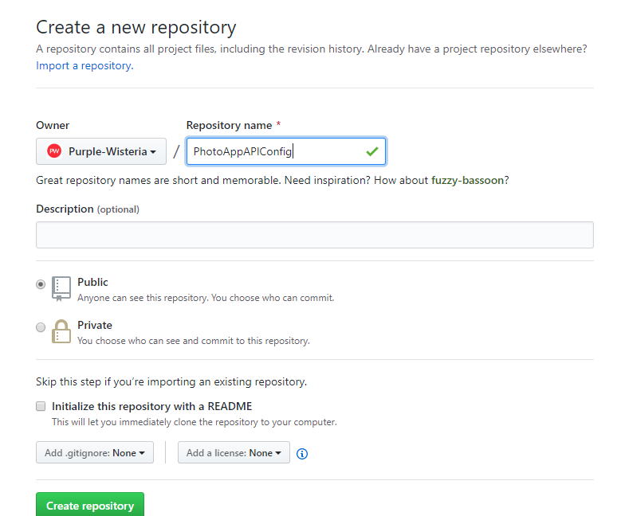

Slide 6
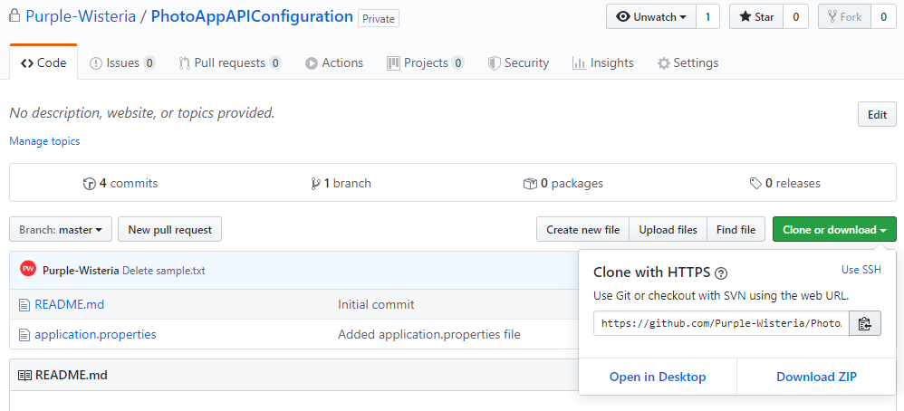
Git Clone command:
Clone Git Repository to your computer

Slide 7
Naming Property Files Served by Config Server

Slide 8
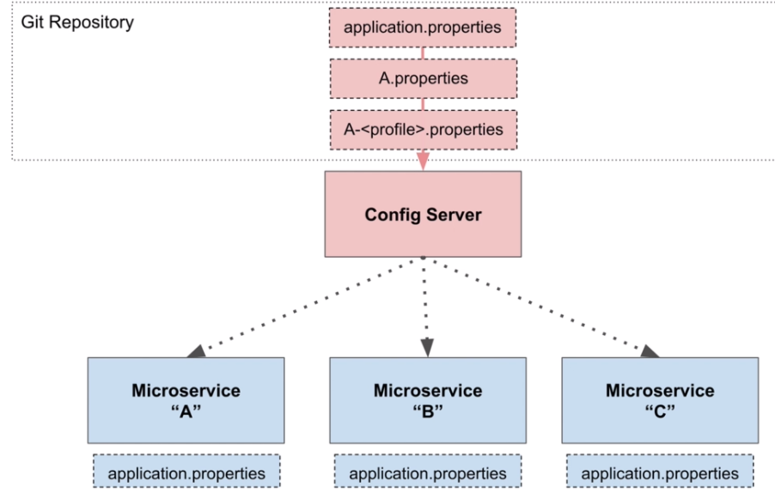

Slide 9
Adding Properties File to Git Repository

Slide 10
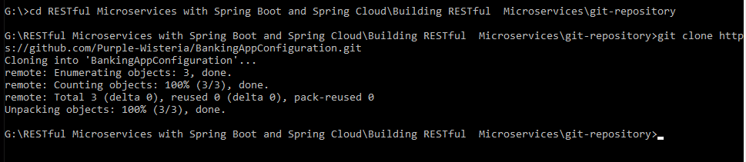
Creating & Cloning Private GitHub Repository

Slide 11
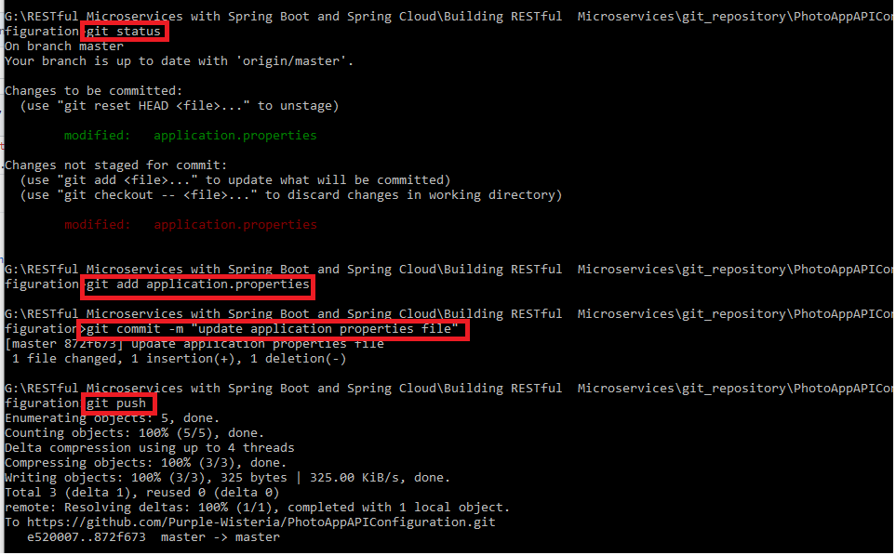
>git status
> git add <file_name>
>git commit –m “desc”
>git push

Slide 12
Error: git: updates were rejected because the remote contains work that you do not have locally when the repo contains some items that are not there locally. So in order to push our changes, in this case we need to integrate the remote changes and then push. So create a pull from remote > git pull Then push changes to that remote > git push More Git commands: https://www.freecodecamp.org/news/10-important-git-commands-that-every-developer-should-know/

Slide 13
Configure Users Microservice to be a Client of Config Server Make Zuul Gateway a Client of Config Server

